Slide 1
The Effects of a Changing Cache Size on ILP
Deborah Rempala
Fall 2015

Slide 2
Background
Instruction Cache
Saves instructions therefore they can easily be reused.
Saves Time when running a program
Instruction Level Parallelism (ILP)
way to overlap instruction therefore, the instructions can run parallel to one another
If the processor has more parallelism, than fewer clock cycles will be executed

Slide 3
The First Cache
First used in commercial in 1968
Designed to be used with a Reduced Instruction Set Computer (RISC) architecture system

Slide 4
Instruction Cache
designed to work with a RISC II architecture system
Has more registers
uses less area
should have higher performance
design a single chip that combines the CPU with an instruction cache

Slide 5
Four Architecture Ideas
Expansible Cache
How The System Deals with Fault Tolerance
Remote Program Counter
Compacting All The Instructions

Slide 6
Memory Chip
Execute easy to decode RISC I instruction
Cache and memory size would be 20 to 25 percent smaller
Improve Hit Ratio
Improve the memory usage and the number of cycles a program will need to use

Slide 7
Improving Cache Instruction Hits
Optimized compiler
Layout of the code
Four General Ideas
Operating system's code is used frequently
Plenty of spatial locality in any of the operating system sequences
Loops have few iterations and really don't call the procedures
Temporal locality in small routines

Slide 8
Experiment Overview
Various Sizes of Instruction Cache
Number of Misses will be calculated
This will then give an idea of how many instructions are not in the cache
Min: 1k Cache
Max: 64k Cache

Slide 9
Programs Used to Run Analyzer On
8q.trace
clinpack2.O.trace
livermore.trace
Can be found in /colossus/ classes/ cs415/trace

Slide 10
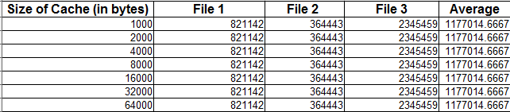
Table 1: Number of Cache Accesses
Expected Theses to all be the same

Slide 11
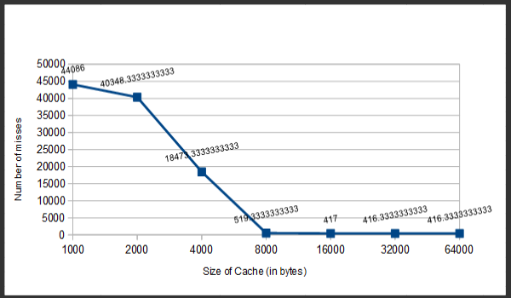
Figure 1: The Average Amount of Cache Misses on a Fully-Associative Cache

Slide 12
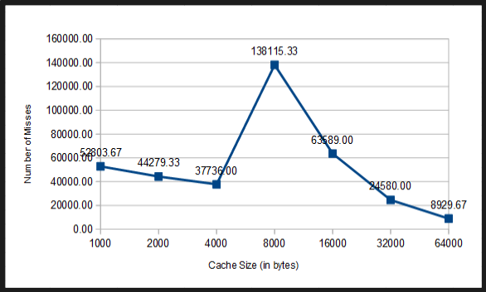
Figure 2: The Average Amount of Cache Misses on a Two-Way Set Associativity Cache

Slide 13
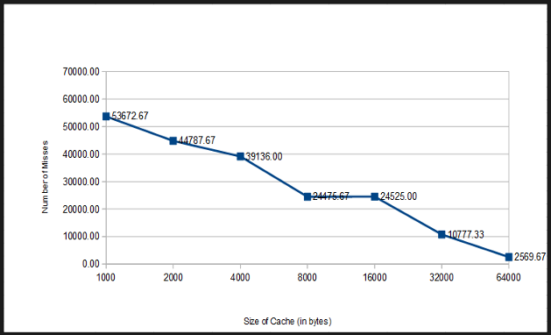
Figure 3: The Average Amount of Cache Misses on a Four-Way Set Associative Cache

Slide 14
Results
Best cache design is the fully-associative cache
One to One Mapping
Relates to Instruction Level Parallelism
Number of misses dictate how many instructions were not in the cache
Instructions the cache could run simultaneously and which instructions could overlap
Fetch it from main memory which would then add a NOP to the other phases

Slide 15
Results Cont’d
Four- Way Associative Cache Took the Longest
Had to look in four different places before deciding it was in the cache
Around 5 minutes for each test run to complete

Slide 16
Further Study
Cost Analysis
See How much an actual system like this would cost
Continued Experiment on Larger Cache Sizes
See if all the instructions could fit and what the run time would be
Smallest Cache
See which Size would be most affordable

Slide 17
Questions?

